Slide 1
CS465-Challenging Project
3D Elevation Map
By Hermann Yepdjio

Slide 2
Introduction
The goal of the project was to simulate some sort of irregular surface and color it based on the elevation.

Slide 3
Tools
Mayavi 4.5.0
Python 2
Numpy
OsGeo
Dem files (Downloaded from the internet)

Slide 4
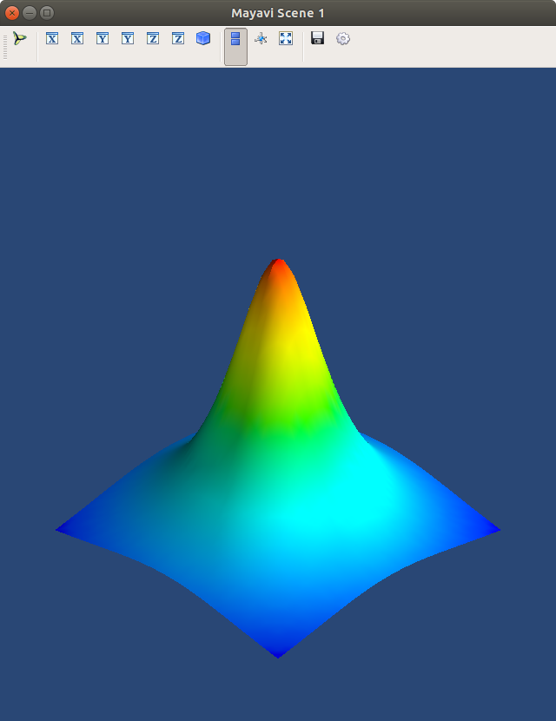
Application 1

Slide 5
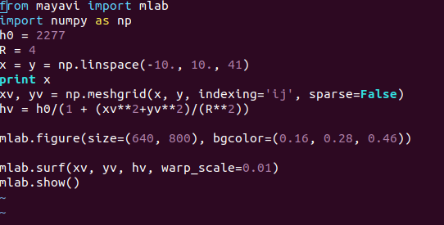
Application1 (Code)

Slide 6
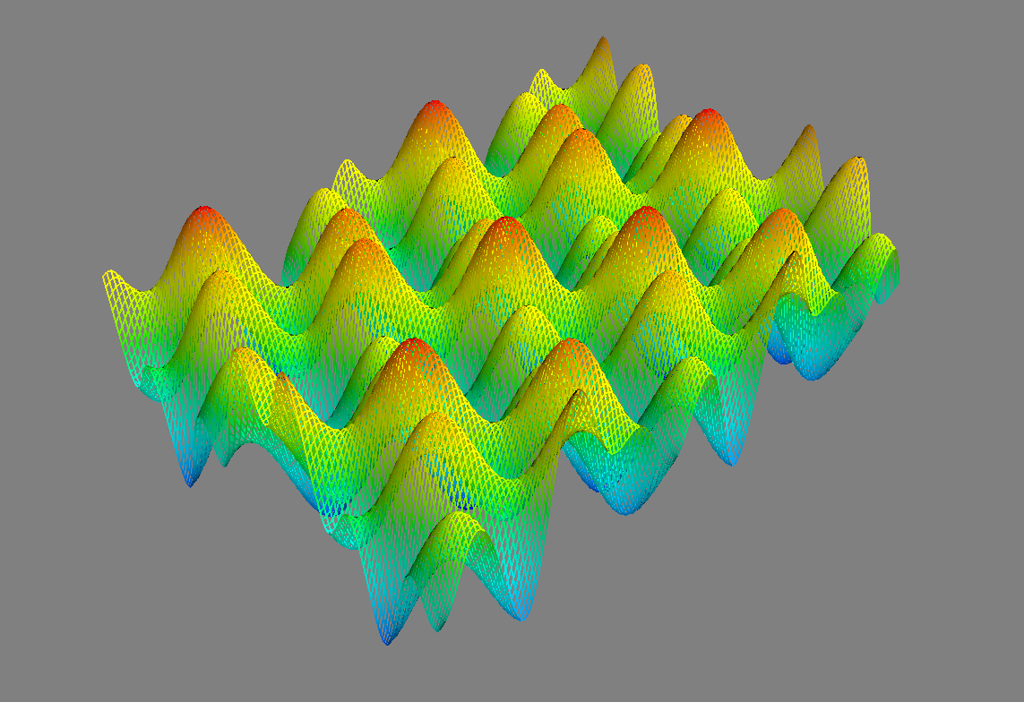
Application 2

Slide 7
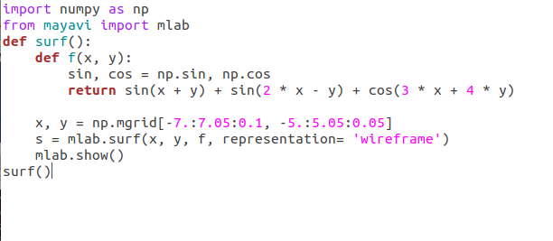
Application2 (code)

Slide 8
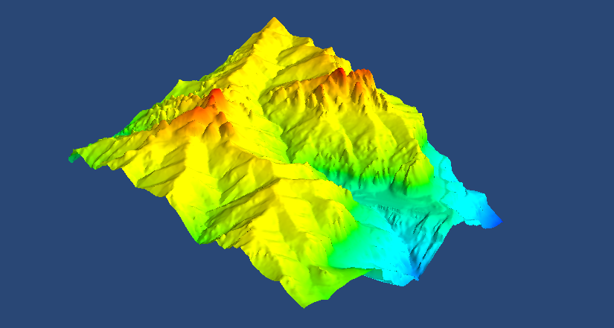
Application 3

Slide 9
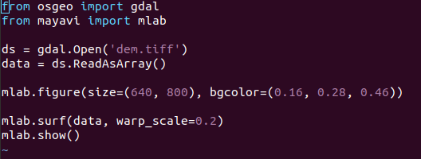
Application 3 (code)

Slide 10
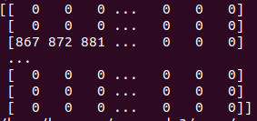
Data table

Slide 11
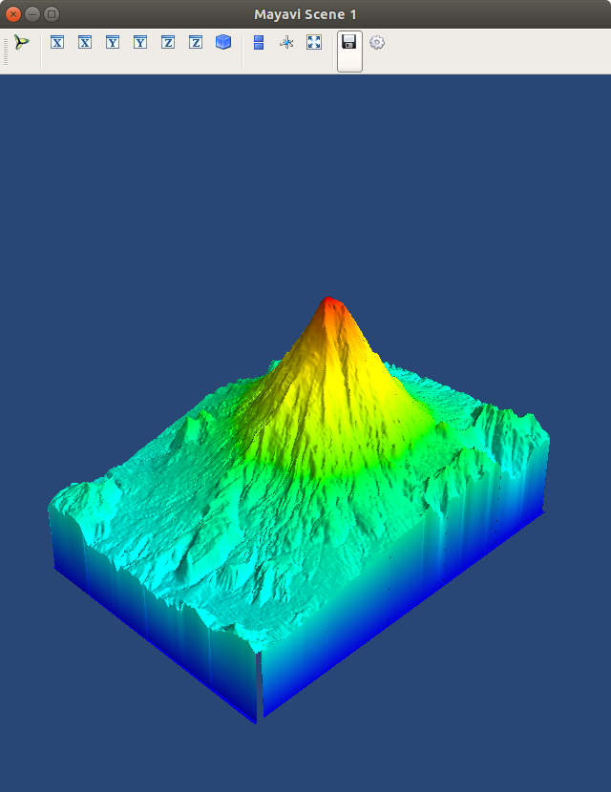
Application 4 (Mt St. helens before the eruption)

Slide 12
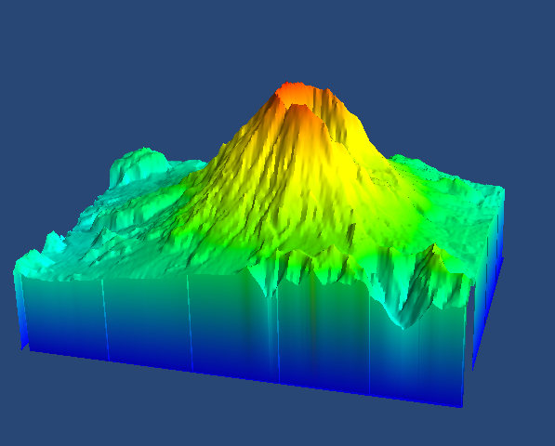
Application 5 (Mt St. Helens after the eruption)

